Slide 1
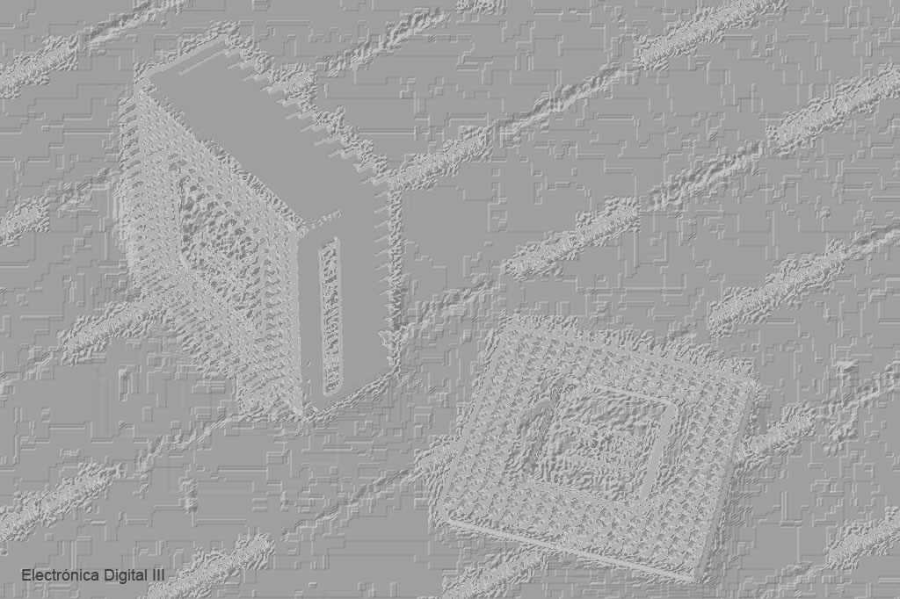
Electrónica Digital III

Slide 2
/******************************************************************************/
/* BLINKY.C: LED Flasher */
/******************************************************************************/
#include <LPC21xx.H> /* LPC21xx definitions */
void wait (void) { /* wait function */
int d;
for (d = 0; d < 1000000; d++); /* only to delay for LED flashes */
} /* 0x000F4240 = 1000000 */
int main (void) {
unsigned int i;
/* LED var */
IODIR0 = 0x00000F00; /* P09..11 defined as Outputs */
while (1) { /* Loop forever */
IOSET0 = 1<<10;
wait (); /* call wait function */
IOCLR0 = 1<<10; /* Turn off LED */
IOCLR0 = 1<<11; /* Turn off LED */
wait (); /* call wait function */
IOSET0 = 1<<11; /* Turn on LED */
}
}

Slide 3
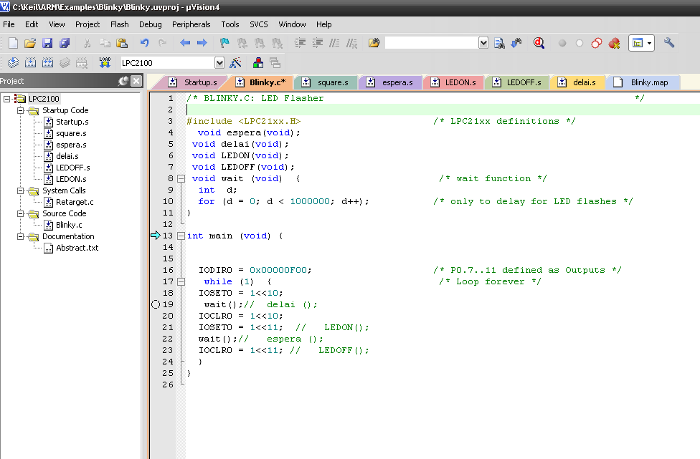

Slide 4
/******************************************************************************/
/* espera.s */
/******************************************************************************/
AREA |.text|,CODE, READONLY
EXPORT espera
espera
MOV r0,#0x001000000
bucle
SUBS r0, r0, #1
BNE bucle
MOV pc, lr /* es igual a r14 */
END

Slide 5
/******************************************************************************/
/* delai.s */
/******************************************************************************/
AREA |.text|,CODE, READONLY
EXPORT delai
delai
MOV r0,#0x000400000
buclei
SUBS r0, r0, #1
BNE buclei
MOV pc, lr
END

Slide 6
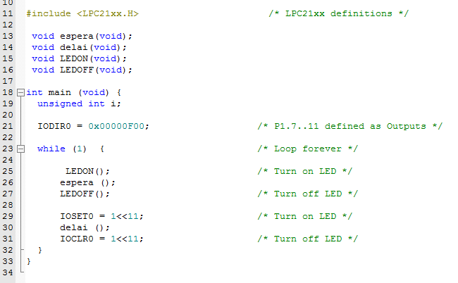

Slide 7
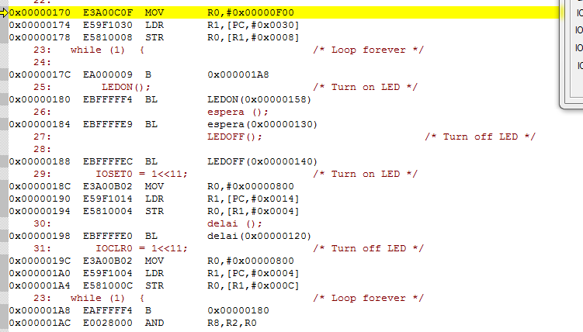
Programa principal Traducido a Assembler

Slide 8
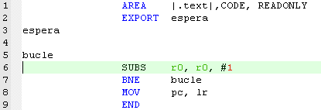

Rutina en Assembler y Lenguaje Máquina

Slide 9
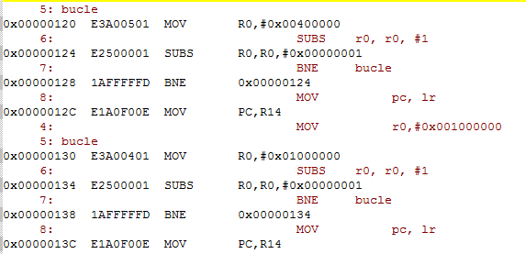
Rutimas de Delai y Espera (son iguales)

Slide 10
/******************************************************************************/
/* LEDON.s */
/******************************************************************************/
AREA |.text|,CODE, READONLY
EXPORT LEDON
LEDON LDR R1,GPIOSET
MOV R0,#0x00000800
STR R0,[R1]
MOV pc, lr
GPIOSET DCD 0xE0028004
GPIOCLR DCD 0xE002800C
END

Slide 11
/******************************************************************************/
/* LEDOFF.s */
/******************************************************************************/
AREA |.text|,CODE, READONLY
EXPORT LEDON
LEDOFF LDR R1,GPIOCLR
MOV R0,#0x00000800
STR R0,[R1]
MOV pc, lr
GPIOSET DCD 0xE0028004
GPIOCLR DCD 0xE002800C
END

Slide 12
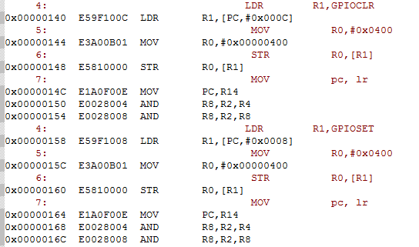
Constantes definidas en Assembler

Slide 13
Constantes definidas en Assembler

Slide 14
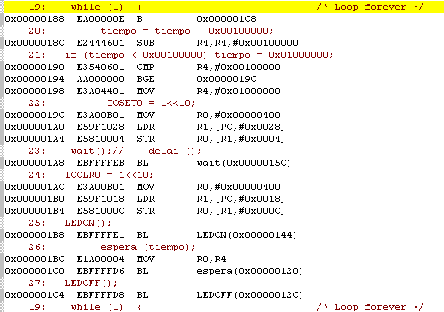
Pasaje de Constante a Rutina espera(tiempo)

Slide 15
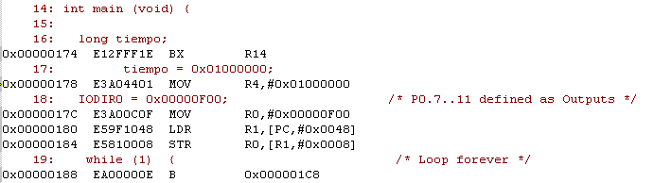
Almacenamiento de Valores definidos en “C”

Slide 16
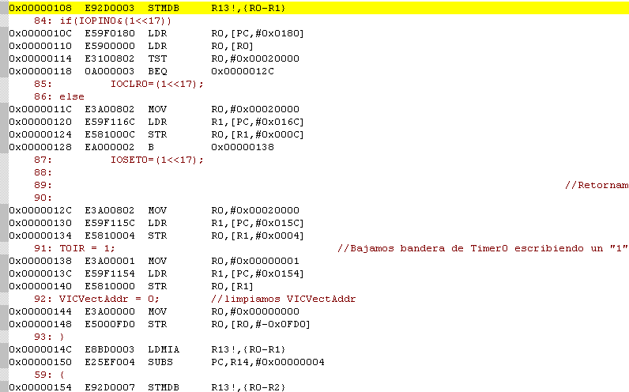
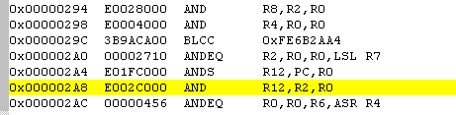
0x0000016C
0x00000008 => 0x00000294 = R1
0x00000120
Traducción de “C” a Assembler

Slide 17
0x00000180
0x00000008 => 0x00000294 = R0
0x0000010C
Traducción de “C” a Assembler

Slide 18
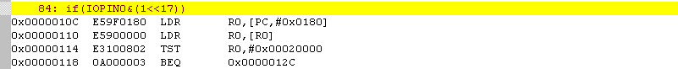
Traducción de “C” a Assembler
0x00000180
0x00000008 => 0x00000294 = R0
0x0000010C

Slide 19
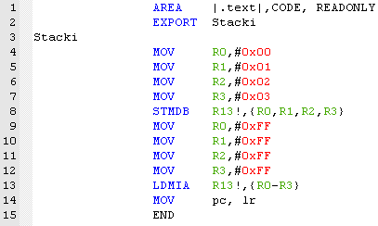
Utilización del Stack

Slide 20
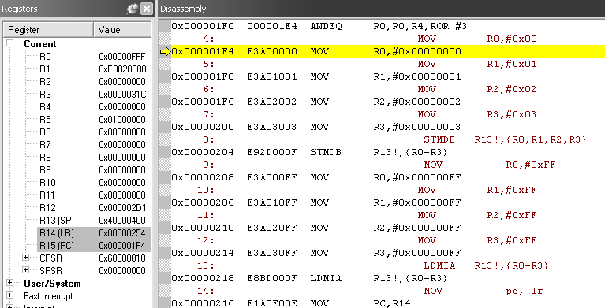

Slide 21
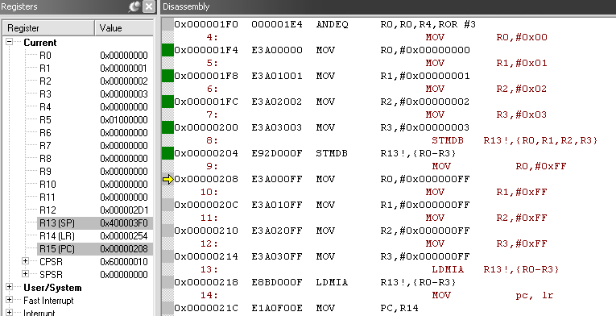

Slide 22
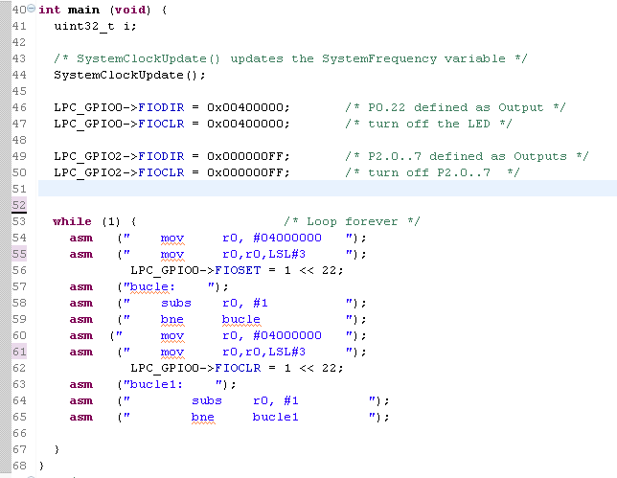
Parpadeo de LED en LPCXpresso

Slide 23
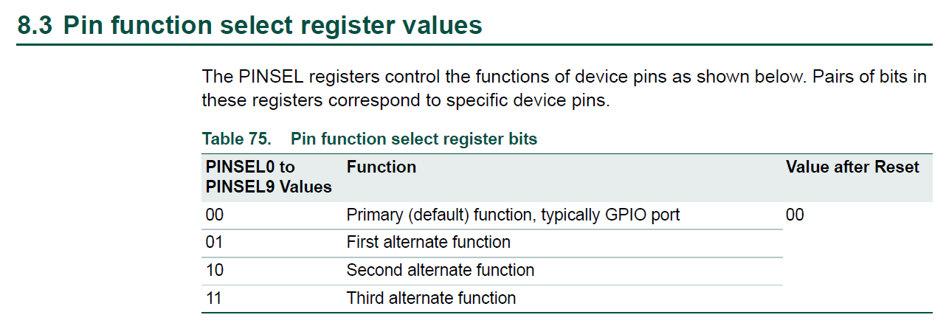
Programación de cada pin del Procesador (2 bits)

Slide 24
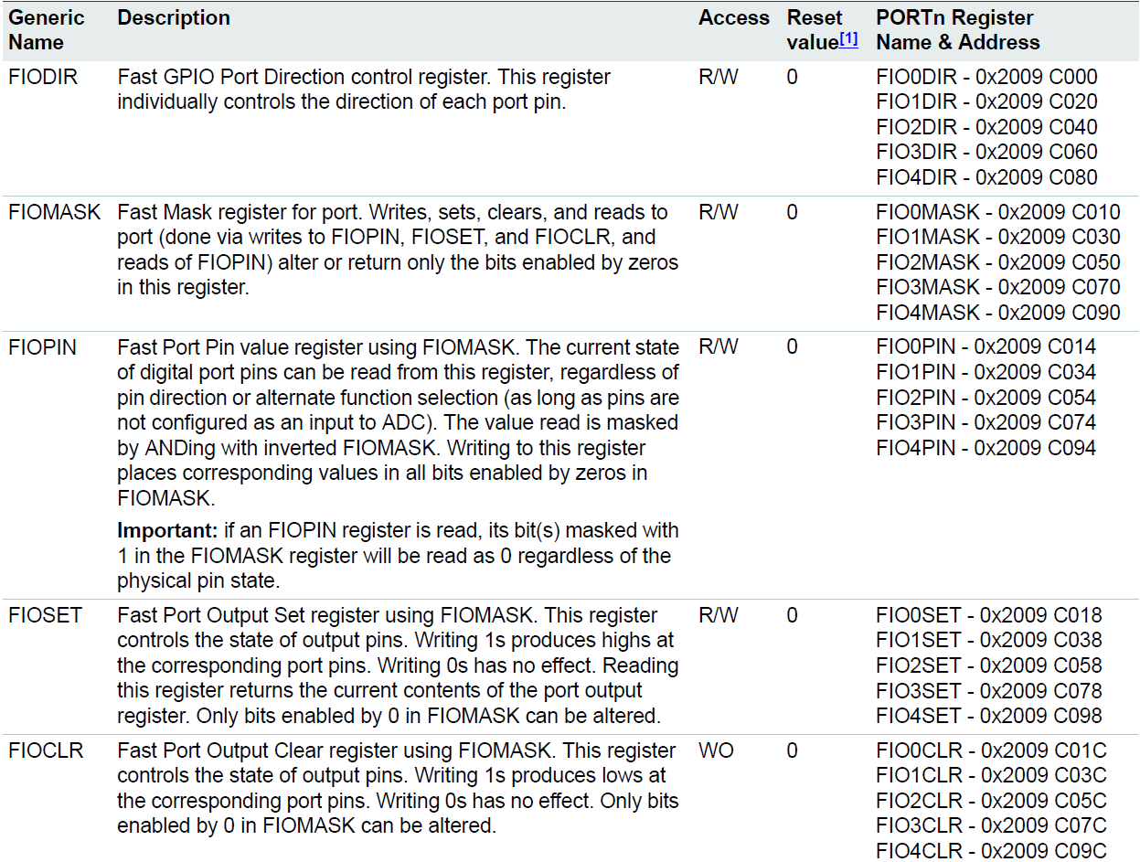
GPIO = General Purpose I/O Registers

Slide 25
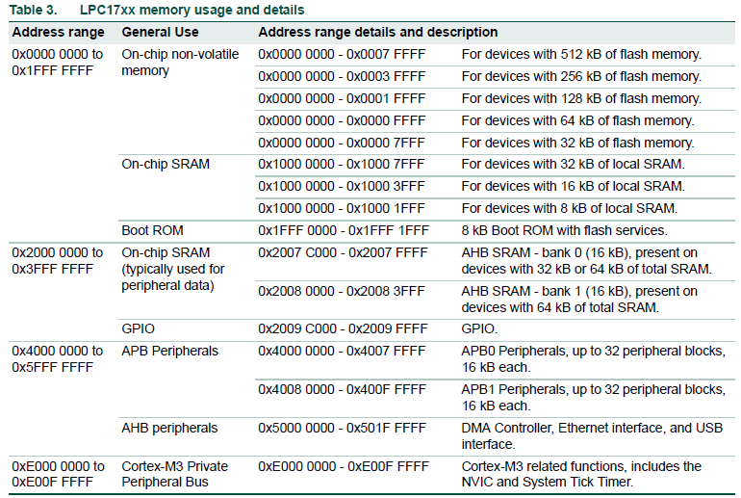

Slide 26
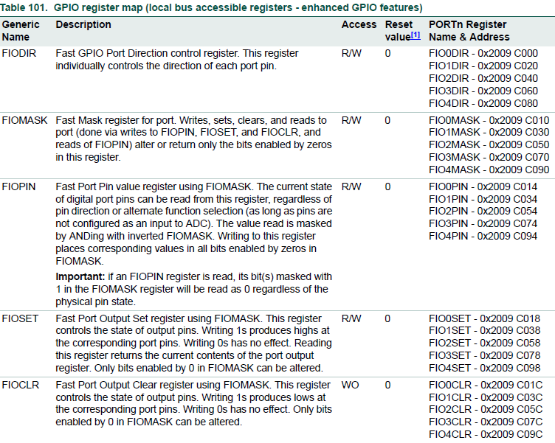

Slide 28
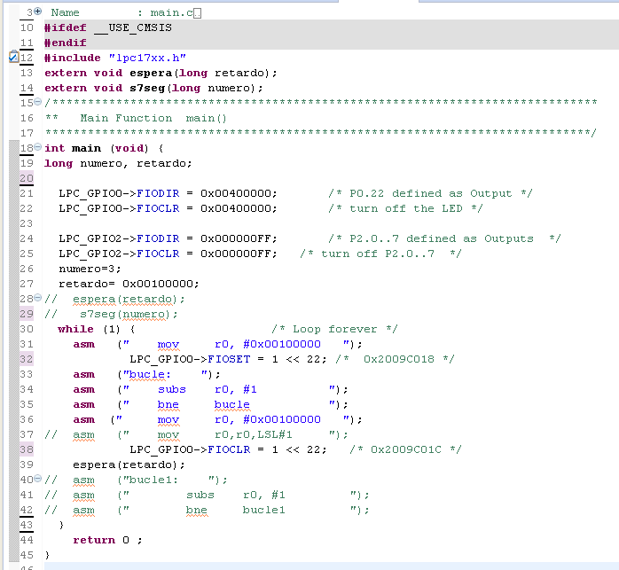

Slide 29
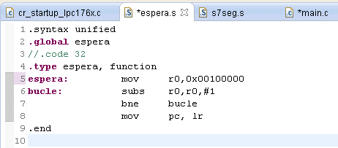
Espera mediante un bucle fijo

Slide 30
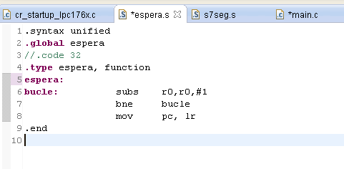
Espera mediante un bucle por parametro

Slide 31
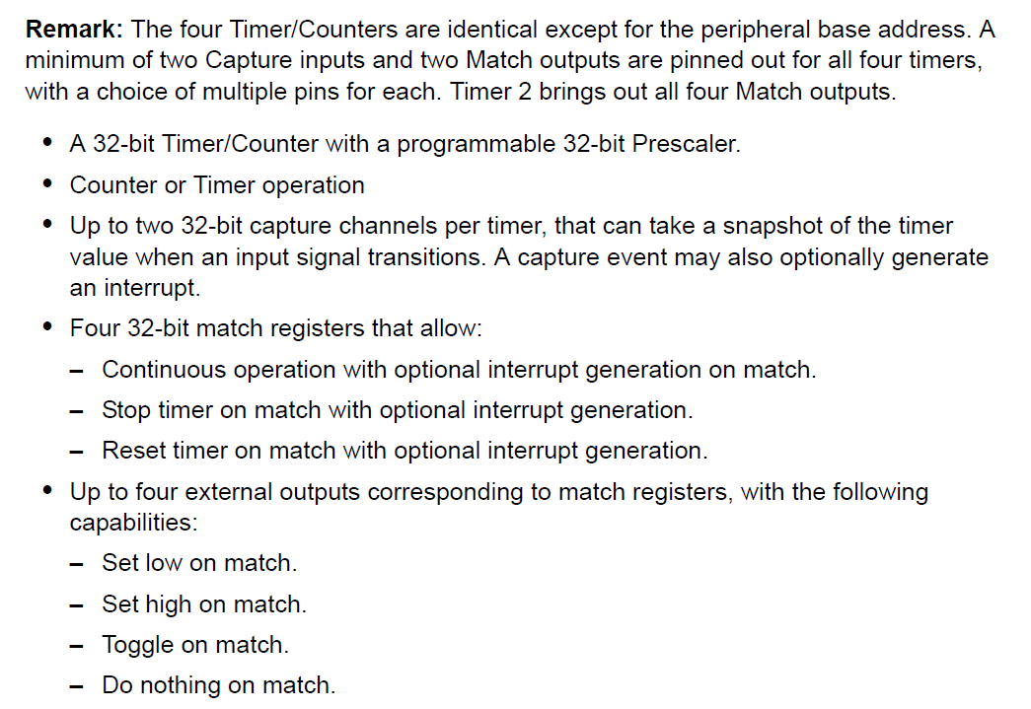
Temporizadores - Timers

